Slide 1


Kigen Brand Book
v3.0
Issue: 2025
© 2025 Kigen (UK) Limited

Slide 2

Hello!
We’ve created some guidelines to help you use our brand and assets, including our logo, content and trademarks, without having to negotiate legal agreements for each use.
To make any use of our marks in a way not covered by these guidelines, please contact us via logo-request@kigen.com and include a visual mock-up of the intended use

Slide 3

Inside Kigen’s brand
01.
Table of Contents
Who we are How do we describe the need for Kigen
Brand values
Persona and personality
Voice and tone
02.
Logo guidelines
Visual guidelines Typography
Image use and guidance
Iconography Logo signage and merchandise usage
03.
Governance
Trademarks Third party usage

Slide 4
01. Inside our brand
In this section, we outline the building blocks of the Kigen brand, including what we stand for, what sets us apart, why we choose the words we use and how we show up in the world.

Slide 5
For over 15 years we’ve partnered with customers to unlock new growth with new ways of securing connectivity.
At Kigen, we’re making the future of secure connectivity simple. As simple as it can be. Together with our partners and customers we are unlocking new opportunity as the SIM evolves.
We are willing to rethinking the future, believe in the art of the possible and to set in motion transformation technology. Our vision is a world where every device can connect securely and reliably.
Please use “Kigen” as an adjective followed by a description of the services we offer. “Kigen” should not be used as a verb, plural or possessive.

Slide 6
Why does the industry need Kigen?
Challenge
SIM is evolving and brings a tectonic shift in security foundations. Our partners and customers need to navigate uncomfortable choices as the market disrupts with new demands driven by connected lifestyles.
Solution
Kigen offers a path forward. In ever evolving technology world, we are the trustworthy path that connects to opportunity.
Meaning ‘origin’ in Japanese, Kigen leads to an era of secure by design connected things.
Result
With Kigen, business have the power to get closer to their customers and offer security through SIM, eSIM, iSIM as they choose.

Slide 7
Why Kigen?
Security is a pillar of modern society. Our customers and partners work with us for the aspiration, confidence and trust our way of working brings for the avoidance of risk in their pivotal moments.
We found inspiration in the Japanese for origin or ‘genesis’, as we want a world where all connected things and their data flows are authenticated at the very get-go.
We bring ease for customers, to see the flow to a world otherwise wary of change.
We typically pronounce it with emphasis on the first syllable: kee-gun. But we’re not prescriptive about it. We welcome other pronunciations too.

Slide 8

Empathy
Kigen brand values and personality
Our brand reflects our culture and values as a company and is an external expression of us. So we live by
Curiosity. Understanding.
We are willing to look at the world sideways, engage and learn. We are thoughtful, respectful and purposeful.
Competent
Reliable. Authentic.
We are confident, live the principles of making things simple. Spell out, drop the jargon – willing to cultivate the trust to help move things forward.
Thriving
Daring. Imaginative
We are revelling in the opportunity to do our part in crafting a secure future and supporting others in doing so. We are courteous however bold our vision.
Be excellent to all.
The key to sounding like Kigen is to speak directly and simply. Show we like the people we are speaking to, and proud of what we are talking about.
Keep it clear and concise
Confident but not arrogant
Intelligent but speaking to equals
Helpful but not stifling
8

Slide 9
02. Logo guidelines
In this section, we outline the best practices for use of the Kigen brand assets.

Slide 10
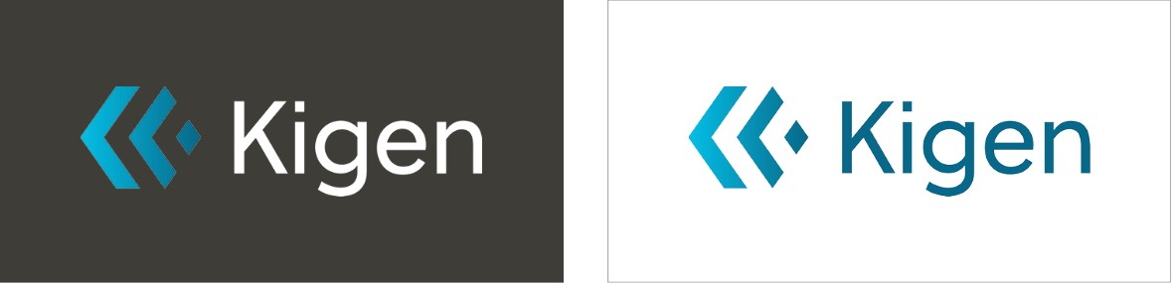
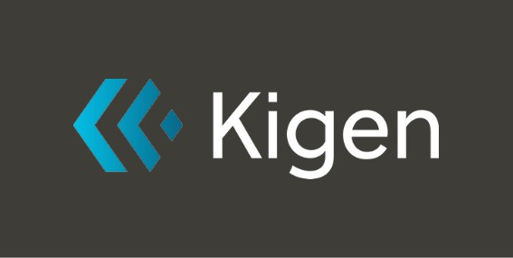

Logo
Horizontal Lockup

Slide 11
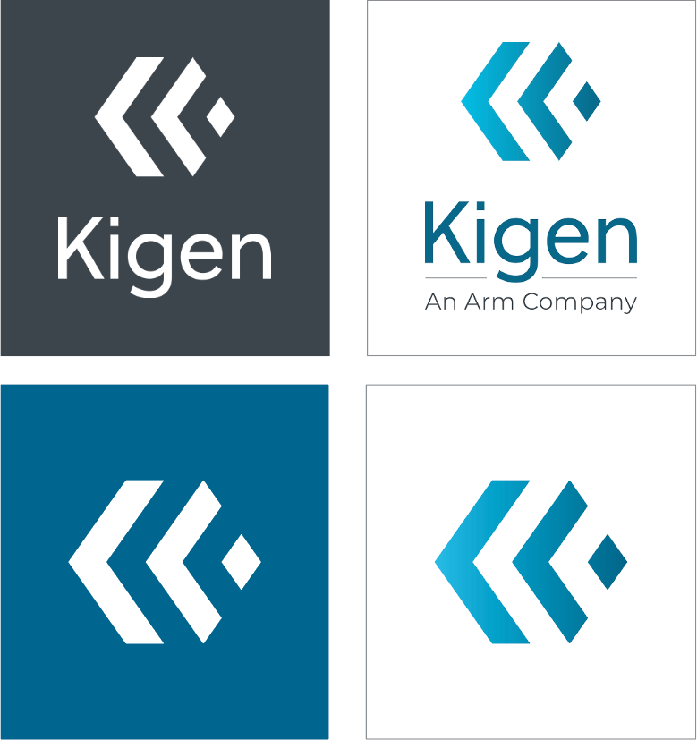

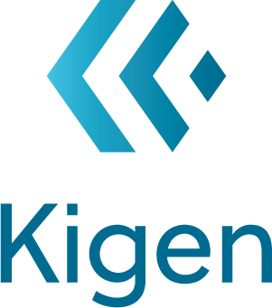


Logo
Vertical Lockup
A vertical lockup can be used when the horizontal lockup doesn’t fit the space. The Kigen ‘Lock’ can also be used as standalone without the ‘Kigen’ text. Single colors logos like white and black should only be used when color usage is limited e.g. one color print.
Kigen “Lock” Symbol

Slide 12
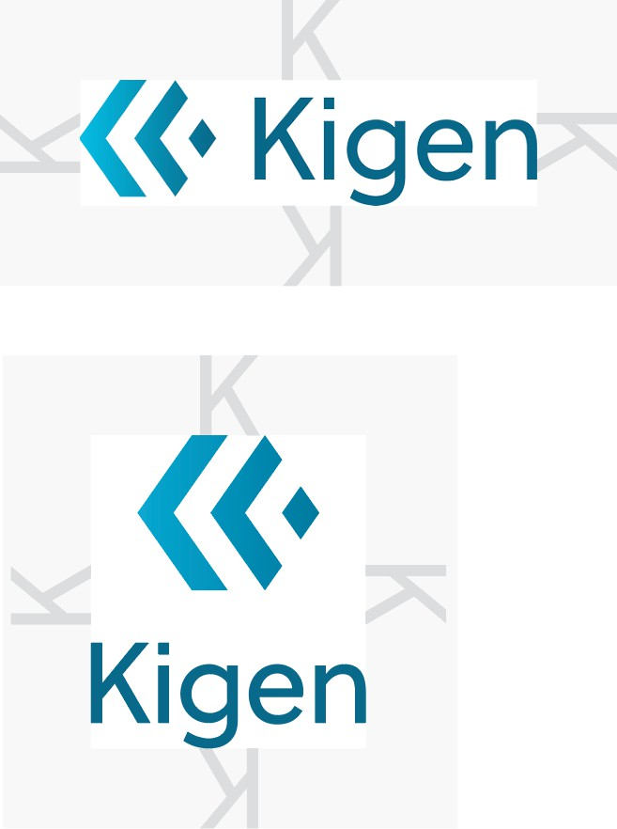
Logo
Exclusion Zone
The exclusion zone protects our logo by giving it a minimum amount of breathing room. This is equal to the ‘K’ height of the Kigen logo.

Slide 13
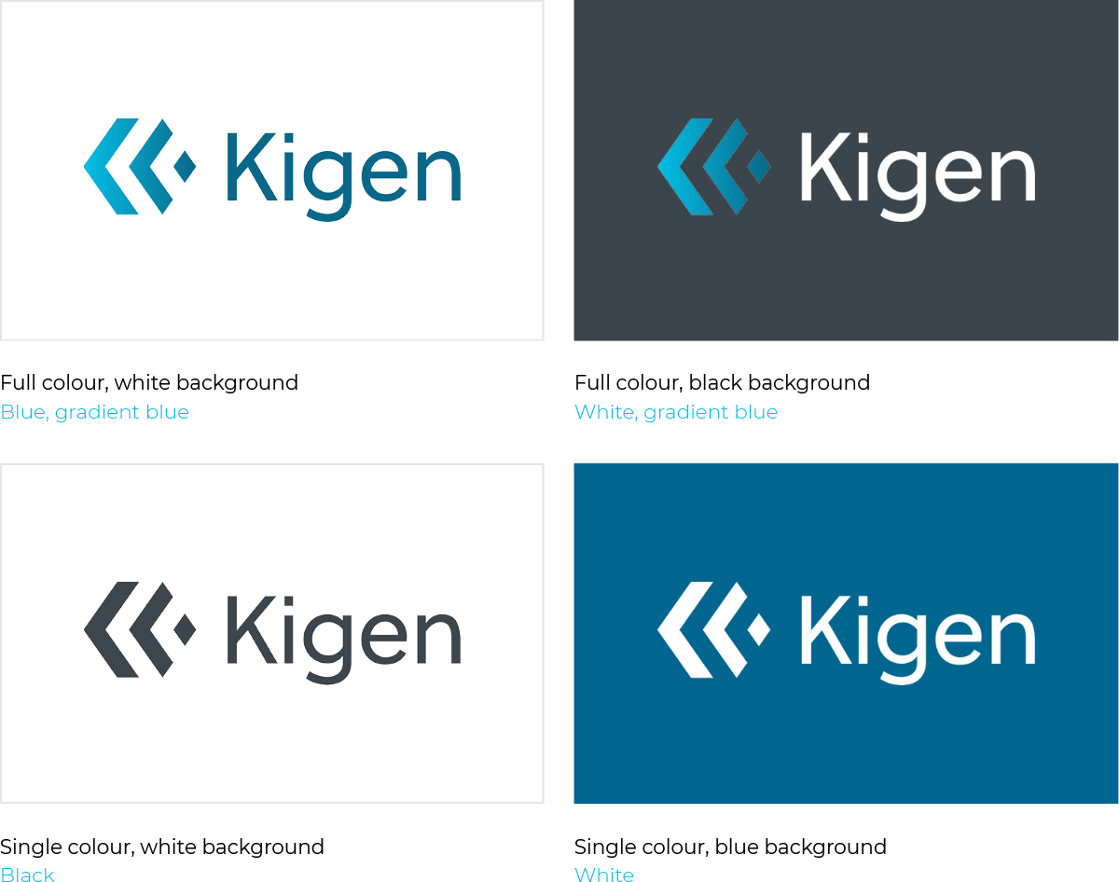
Logo
Color Usage
Different color variations of the logo should be used on different backgrounds. Use the following as a guide only.
Full colour, black background White, gradient orange to green
13
© 2025 Kigen (UK) Limited

Slide 14
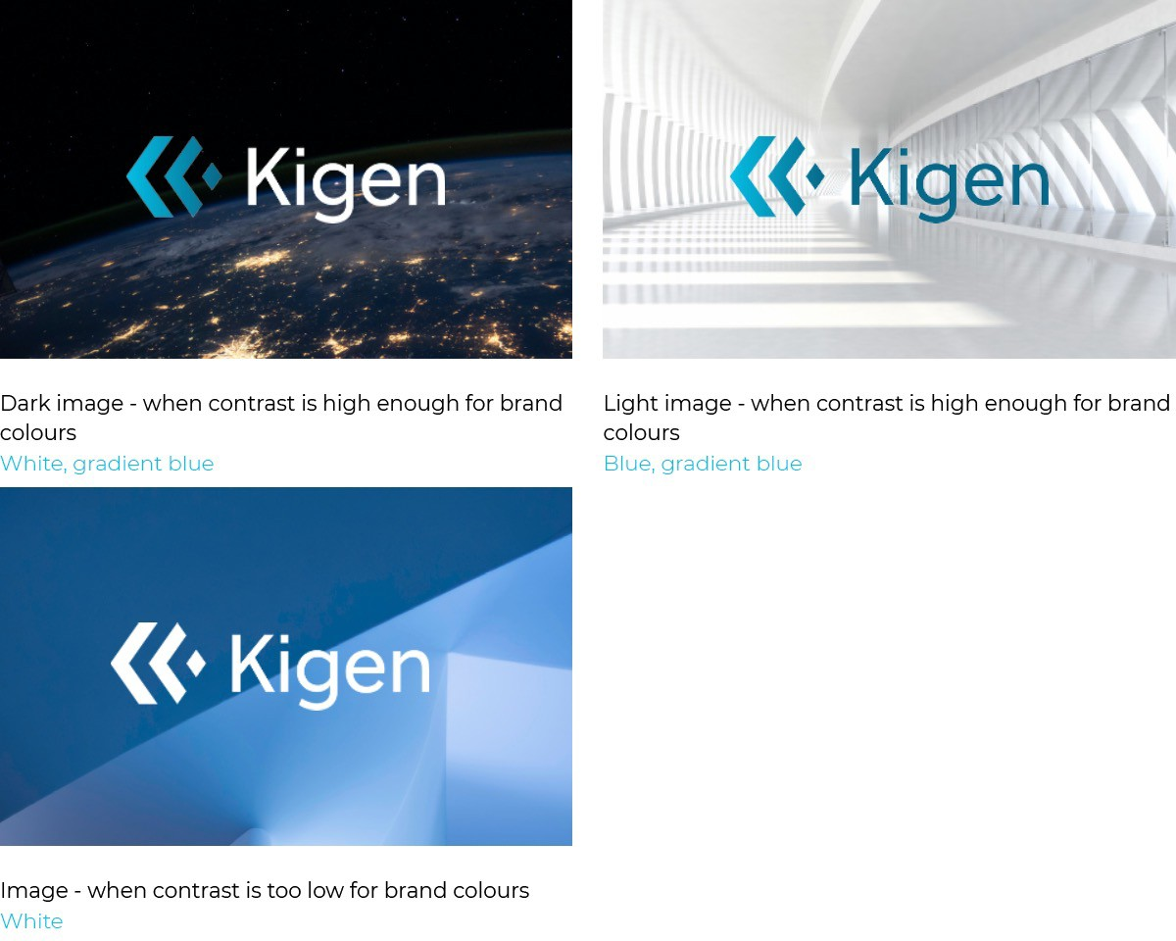

Logo
Color Usage- Images
Similar principles should be considered when placing logo over images.
Dark image- when contrast is high enough for brand colours
White, gradient orange to green

Slide 15
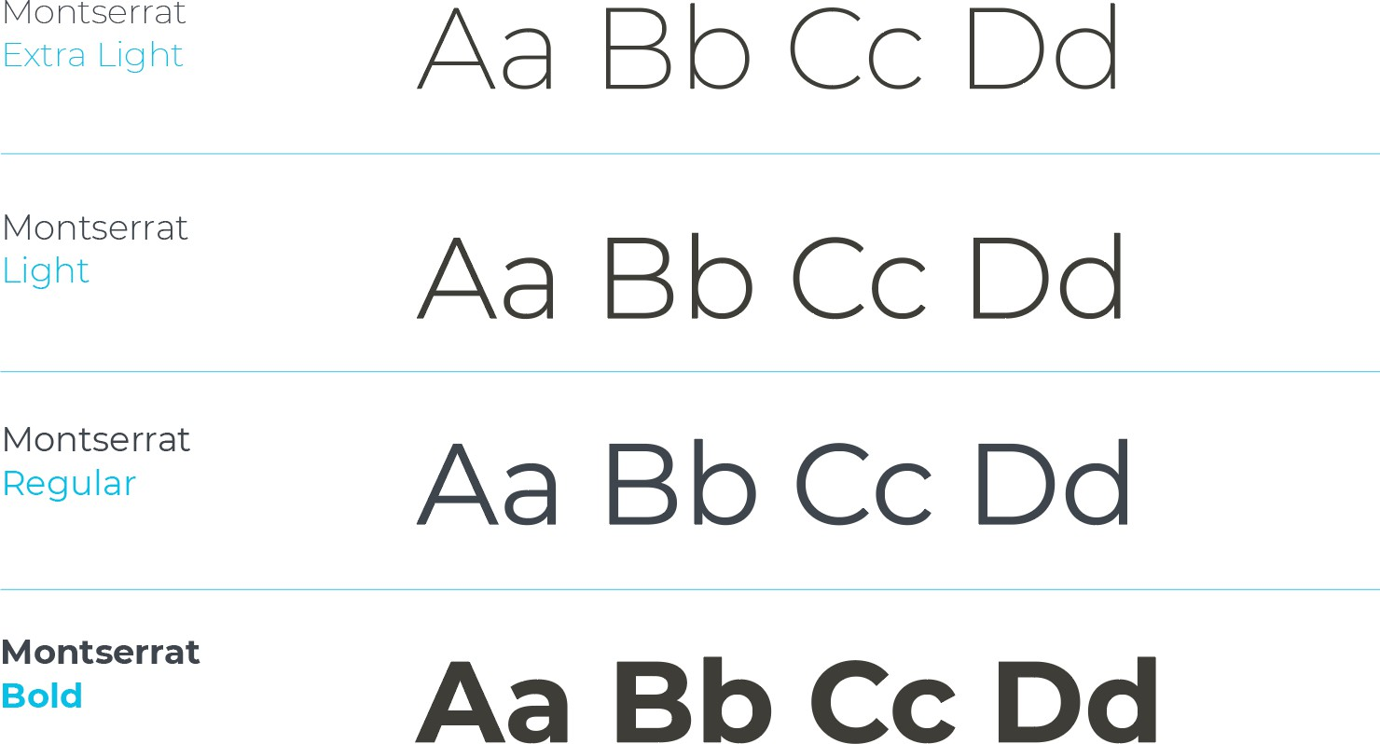
Typography
Montserrat is the primary Kigen brand typeface and should be used across all placements. Montserrat Regular is primarily used as body copy across print and digital. Montserrat Light or Extra Light is recommended for headings, while Montserrat Bold is recommended for secondary copy lines such as sub-headings.

Slide 16
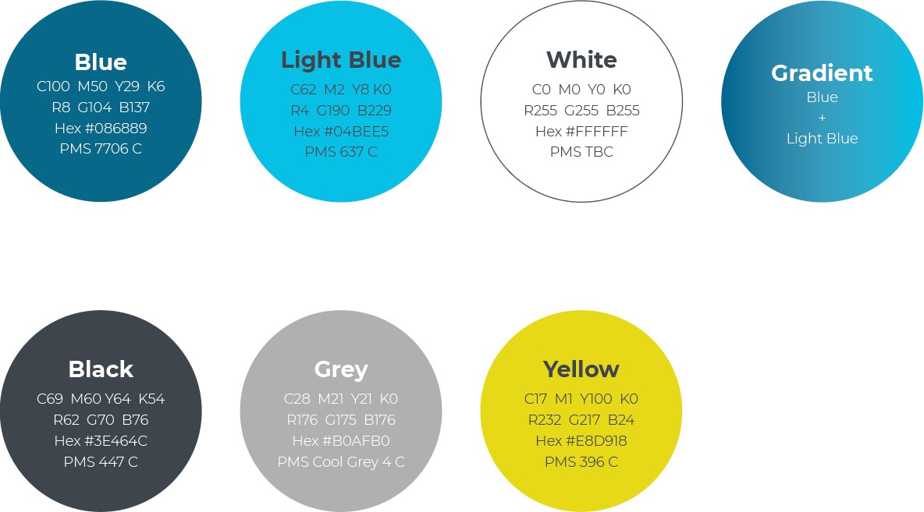
Color Palette
Primary
Secondary
Orange
C8 M31 Y100 K0 R235 G177 B25
Hex #EBB119
Gradient
Light Pink
C17 M19 Y5 K0
R209 G195 B211
Hex #D1C3D3
Light Blue
C35 M12 Y2 K0
R159 G194 B222
Hex #9FC2DE

Slide 17

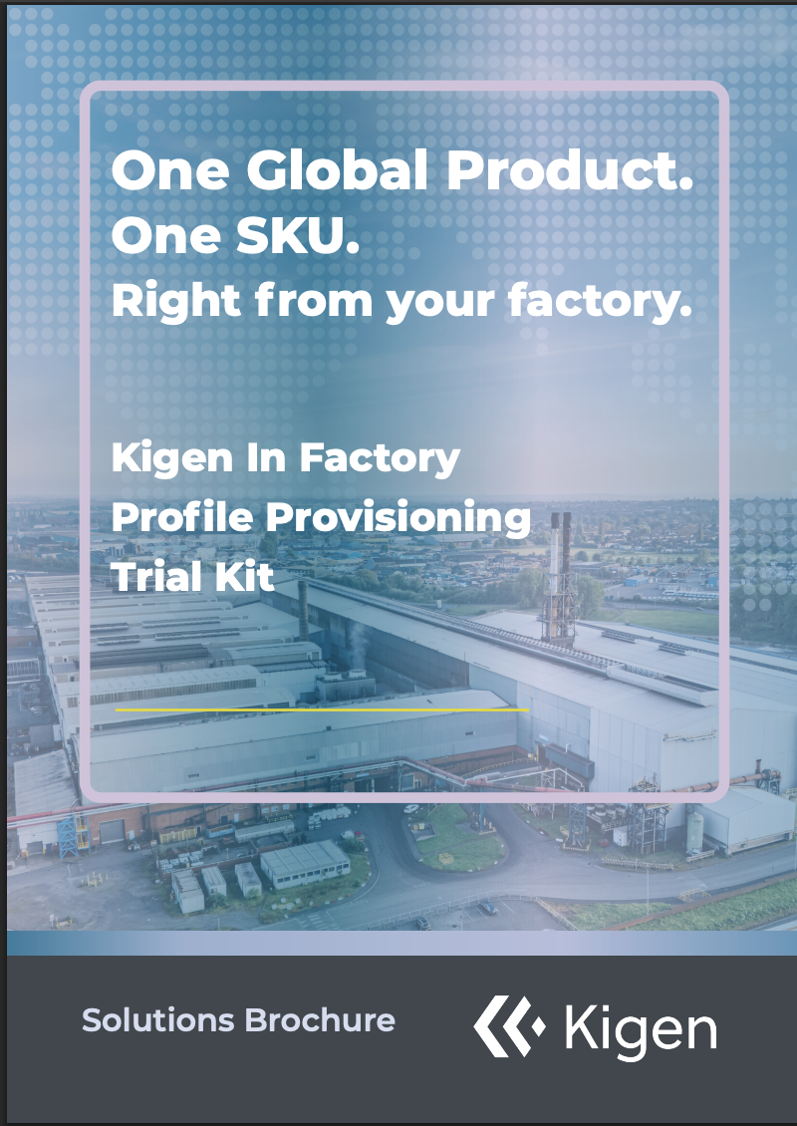

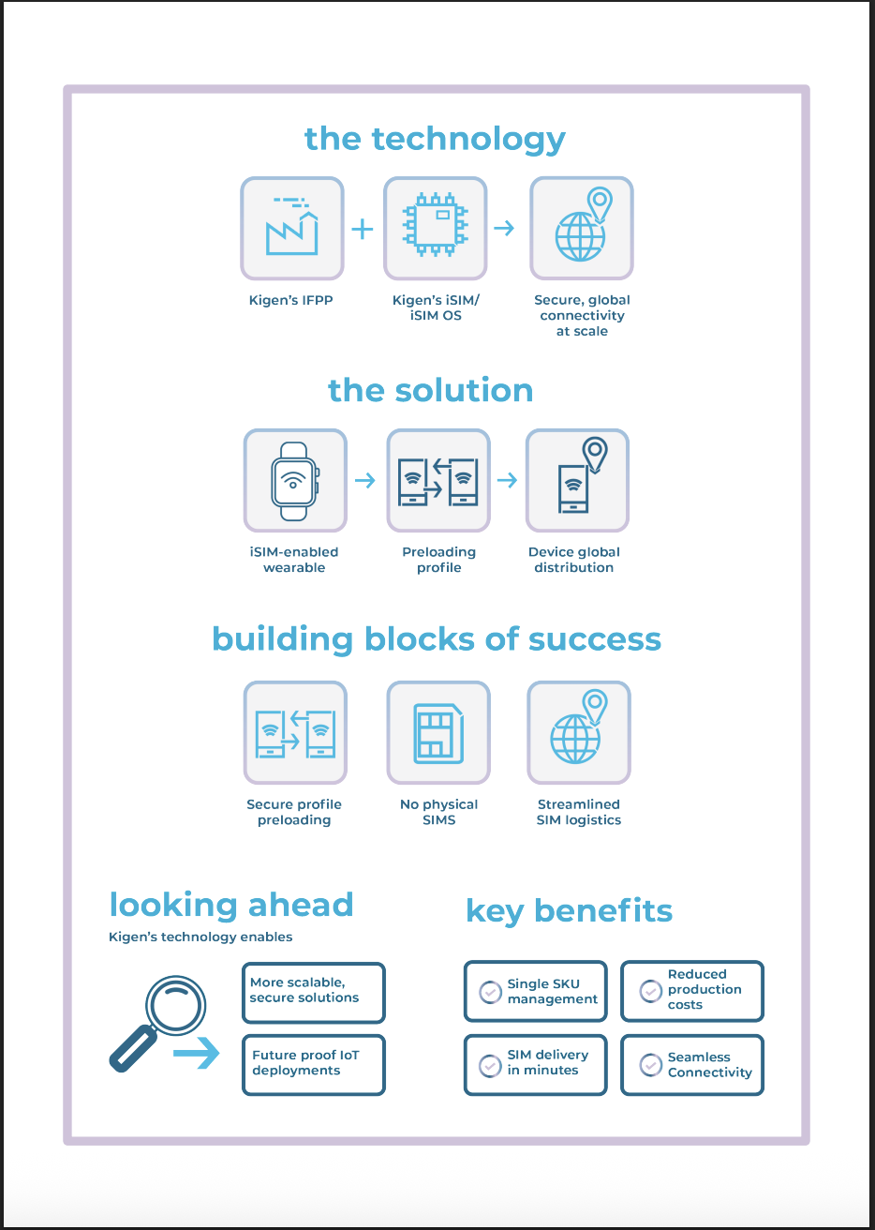

Branding Refresh

Slide 18




Hashtag
Hashtags help to foster engagement and enhance visibility, strengthening Kigen’s brand identity across multiple platforms. Kigen uses the hashtag “FutureofSIM.” which should be written in Montserrat Italic, with ”SIM” added in bold. Examples shown below in the rectangle boxes.
#FutureofSIM

Slide 19


Video
For video content, it is important to include the following, to ensure that it aligns with our branding identity and the content can be recognized as ours.
Front & back slide
Middle slides should include the Kigen lock symbol in the top left corner of the screen as show below
Discover the #FutureofSIM today
kigen.com

Slide 20
03. Governance
In this section, we outline key information about Kigen’s trademarks and resources providing guidelines about using Kigen’s trademarks.

Slide 21
Trademarks
Kigen's trademarks are among the company's most valuable intellectual property assets. They represent the highest standards of quality and excellence associated with Kigen's products and services.
Kigen trademark notice
The Kigen name and logo are trademarks or registered trademarks of Kigen (UK) Limited. All rights reserved.
Please refer to the Kigen website policies at https://kigen.com for more information about using Kigen’s trademarks.

Slide 22
Using the Kigen corporate logo
Please follow these guidelines when using the Kigen logo.
Kigen trademark notice
Do not alter or deform the shape of the logo in any way. The logo must appear exactly as shown: the elements, proportions and relationships must not change.
Do not replace the logotype with a different typeface.
Do not imitate any element of the logo, including its trade dress.
Please include the following trademark notice in all materials: The Kigen name and logo are trademarks of Kigen (UK) Limited. All rights reserved.
Do not use the logo or logotype as an element in titles, headlines or text.
Do not place competing visual elements (including but not limited to other trademarks) close to the logo.
Do not set type near to the logo that could be construed as a corporate slogan or motto.
Do not display the logo more prominently than your own trademarks, logos and names. This includes, but is not limited to company name, trade name, product name, service name, technology name, social media name or handle.

Slide 23
Using the Kigen corporate logo - continued
Please follow these guidelines when using the Kigen logo.
Kigen trademark notice
Do not use or register the logo (or any part of it) as part of another trademark, logo or name. This includes but is not limited to a company name, trade name, product name, service name, technology name, social media name or handle.
Do not use the logo in any manner that expresses or implies that Kigen has any affiliation, sponsorship, endorsement, certification, or approval of your product, service or company.
Do not use the logo to make fun of Kigen or portray Kigen in a negative way.
Any and all goodwill arising from use of the logo inures exclusively to Kigen (UK) Limited.
Kigen reserves the sole right to alter or refuse any permission to any third party to use the Kigen
corporate logo if such use does not comply with
these guidelines.

Slide 24

Thank You
Danke Merci谢谢
ありがとう Gracias Kiitos 감사합니다
ध"यवाद
اﺮً ﻜﺷ
והתד

Slide 25
The Kigen trademarks featured in this presentation are registered trademarks or trademarks of Kigen in the US and/or elsewhere. All rights reserved. All other marks featured may be trademarks of their respective owners.
www.kigen.com

