Slide 1
Ready for CRA? Secure Remote Updates with eSIMs
Join us!
🔥 Campfire session, HW Pioneers Max
Bee Hayes-Thakore
10 June 2026

Slide 2
Key considerations in security of connected devices for 2026
Another ref: https://www.digi.com/blog/post/iot-cybersecurity-trends
Three of the most influential frameworks now in practice
Cyber Resilience Act (CRA)
NIST
Executive Order (EO) 14028
For
Manufacturers
Importers
Distributors
Of all products with digital elements
1
3
Secure by design
is must for all IoT products
Plan for your security patching – considering how to do it at scale
Manufacturers move to IoT eSIM from legacy SIM and M2M eSIM architectures to future-proof trusted device Identity by default.
With volumes set to rise, evaluate choices in eIM and SM-DP+ for ease of at scale patching. Incoming regulations levy up to 15MEuros or 2.5% of total annual revenue
2
4
Product security updates and security monitoring become essential
A $112.4 Billion Global IoT security market by 2030
IoT products needs to be supported for security updates for a minimum of 5 years and have security documentation accessible for 10 years.
The market for loT security globally was estimated at $34.2 Billion in 2023. By 2030, it is estimated that there will be 40 million IoT devices.
Notes:
EU CRA introduces horizontal cybersecurity requirements for all products with digital elements available on the market, ensuring a broad and consistent approach to cybersecurity
Penalties are significant and apply to all players: manufacturers, importers and distributors
Three things to note: Understand initial conformance documentation for your product, develop into your solution ways to identify, patch and resolve/mitigate vulnerabilities
EU CRA also similar rules emerging in US, India, Japan and many others.

Slide 3
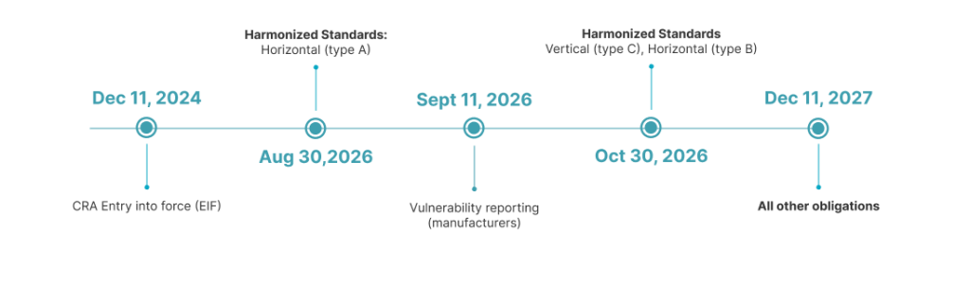
Cyber regulation planning should be part of the build now
Notes:
Entered into Legislative Framework for the EU (hence driver is strengthening EU’s market positioning and posture) on Nov 20,2024

Slide 4
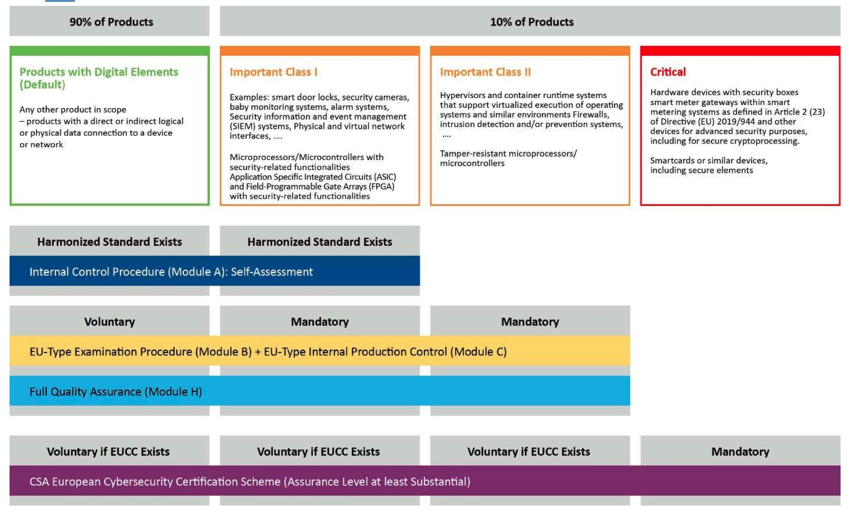
Notes:
All eUICC components are critical and hence require third party risk assement. Module H is the one that defines the patchability

Slide 5


CYBERSECURITY COMPLIANCE & BUSINESS GROWTH
Compliance Is a
Competitive Advantage
Most businesses see it as a growth enabler — not a barrier.
29%
33%
10%
call compliance a
primary growth driver
see it as a secondary
benefit & quality boost
view it as an obstacle
slowing development
Source: GSMA Survey respondents on IoT eSIM security, n = 142 large CSPs, MNOs, Enterprise with IoT fleets.

Slide 6
TRUSTED CONNECTIVITY ALLIANCE | POSITION PAPER | SEPTEMBER 2025
eSIM Security Is Already
EU Cyber Law Ready
GSMA's eUICC Security Assurance (eSA) scheme already meets the essential requirements of the EU Cyber Resilience Act — making it a ready-made conformity pathway for critical connected devices.
✓
Already Proven
⟳
Lifecycle-Long Assurance
→
Clear Path Forward
eUICC specs are built to
resist high-potential attacks
(CC AVA_VAN.5) — the CRA's
essential requirements are
already fully covered.
eSA covers the full product
lifecycle: design, production,
field support & vulnerability
management — aligned with
CRA's 5-year mandate.
TCA recommends eSA as
a CRA conformity module
(Module H), with GSMA
proposed as an EU-recognised
Notified Body.
trustedconnectivityalliance.org
Notes:
A key benefit of eSIM technology is that it is already
supported by an advanced, mature infrastructure that
promotes security and interoperability. A core element
of this infrastructure is the eUICC Security Assurance
(eSA),
eSA is an independent security evaluation scheme for
eUICC software
eSA is based on the Common Criteria
methodology (ISO 15408 , which has been optimised to
maximise process and time efficiencies to reflect device
lifecycles.
eSA scheme evaluates eUICCs against the security
requirements defined in two possible Protection Profiles:
Protection Profile BSI-CC-PP-0089 (SGP.05 and
Protection Profile BSI- CC-PP-0100 (SGP.25 ) developed by the German BSI

Slide 7



About Kigen
Help businesses embrace new opportunities in security through eSIM adoption in devices
Established in 2020 in Cambridge, UK, Kigen is a fabless, UK-based IP leader in secure SIM, eSIM and iSIM OS and profile management for global manufacturers, MVNOs and MNOs.
Vision
Next generation security for humans to trust their devices
Backed by the world’s foremost funds of disruptive technology brands
90% growth on eSIMs under management
Accredited secure eSIM data centers and products
Present in 10
Countries
Kigen is providing and managing the key transitions from SIM to eSIM and iSIM for over 10m devices across industrial and consumer products.
With the world’s first certified servers for IoT eSIMs at scale, Kigen offers GSMA-accredited centers for eSIM production, remote provisioning and in-factory profile insertion.
Serving manufacturers, connectivity partners, and exporters across Europe, North America, and Asia.

Slide 8
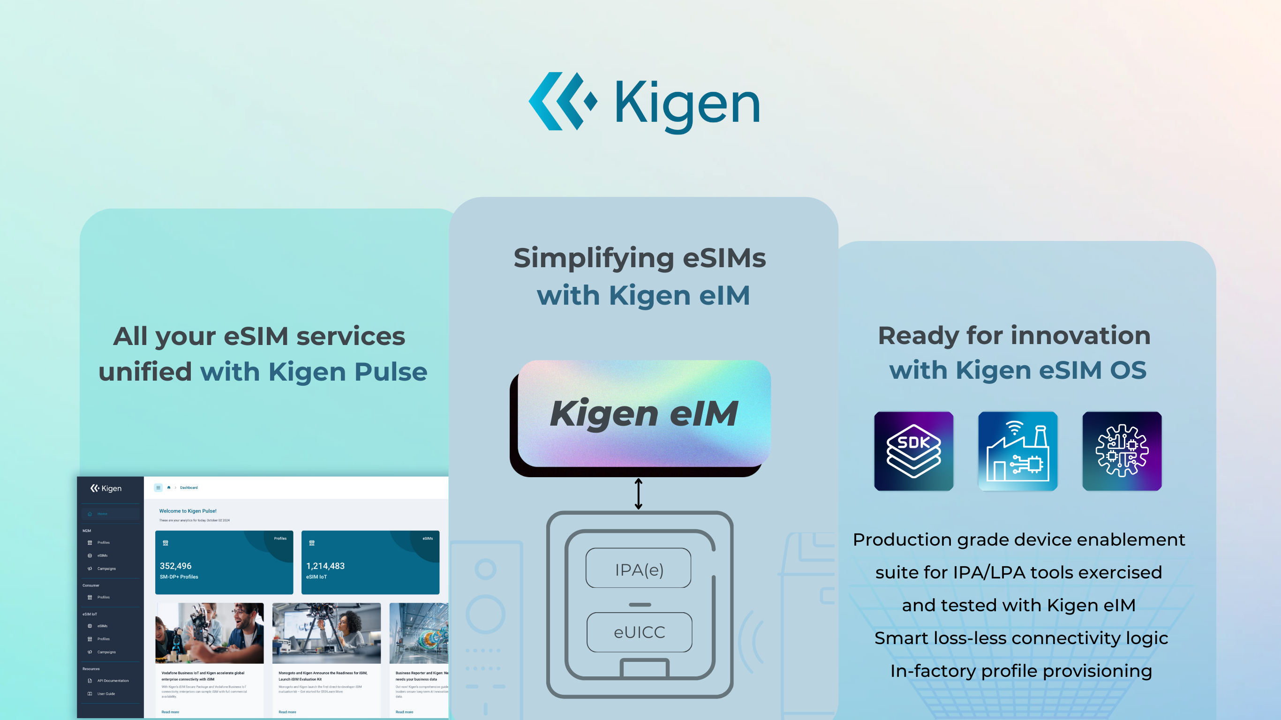
© 2025 Kigen
8
Notes:
OEMs can now transition to production-ready eSIMs, streamlining connectivity management with Kigen’s SAS-SM-certified site and Kigen eIM solution
Scalable Security to confidently scale to millions of devices
When getting started, one key question is do I develop my own eIM or get one? At Kigen, we are providing one that leverages the best capabilities to support the most innovative elements combining our eSIM IoT OS, certified eIM and capabilities of Kigen Pulse – our web portal for eSIM operations management
Highlight – recovery and rescue logic and IFPP inclusion – i.e. its packed with vital utility that can support your path to mass production

Slide 9


ACTIONABLE LIST FOR HARDWARE PIONEERS
MANUFACTURERS
EMBEDDED DEVELOPERS
Design with cybersecurity protections that don’t incur additional costs: for e.g. Secure-by-Design approach with security-assured certified eSIMs.
Make initial cybersecurity testing and documentation for EU declaration of conformity part of your development incl. of SBOM
Build a strategy to achieve CE-marking if applicable
Stand up cyber team for device vulnerability patching and verifying capabilities
Focus on reachability analysis for rapid vulnerability management capabilities
Start designing with certified eSIMs with interoperability, for e.g. Secure with Kigen IoT modules and eIM
Ease your flow for regular polling with an interoperable eIM , preferably SAS certified
Build polling for available updates prioritizing your reachability – does this vulnerability apply?
Test for prototype > pilot > production flow for updates for cost effectiveness prior to deployment
Automate reporting on the verification of applied patches.
Notes:
Manufacturers:
Rigorous risk assessment - extending for 5 years or so
Third Party assessment
Vulnerability management
Manufacturers own the

Slide 10

CRA compliance: How Kigen eSIM stack helps
Kigen eSIM enablement suite is built to address the specific challenges of IoT device integration for the era of SGP.32
Dynamic and automated patch availability alerts
Interoperable SAS-certified eIM for patching
Capable of interrupted patch downloads suited for IoT
Production-grade IPAd/LPA reference with full profile lifecycle ops, exercised and tested with Kigen eIM and SM-DP+
Platform and transport independent, lean C-library that runs across Linux, POSIX, RTOS -reuse your integration in multiple products
Ability to include IoT SAFE support for dynamic certificate management, enabling secure ID
IFPP streamlined for secure multi-profile loading and factory handover at volume
10
© 2025 Kigen
Notes:
Kigen’s eSIM enablement suite was built to address the specific challenges of IoT device integration for the era of SGP.32. Kigen’s approach is deliberately broader for the IPAd, and delivered via our “standards-plus” Kigen Software Development Kit for Embedded C (C-SDK):
Reference implementation first: A production-grade IPAd/LPA reference, with profile lifecycle operations (download, enable, disable, delete, list, notifications, EID), exercised against eIM and SM-DP+ with defined unit, regression, and integration tests.
Portable C-SDK and middleware: A platform-independent, lean C-library with transport/network abstraction and ASN.1 parsing that runs across Linux, POSIX, and established RTOS—so teams can reuse one integration across multiple products and chipsets.
Security built in: Optional IoT SAFE support for dynamic certificate management, enabling secure identity and credential rotation without bolting on separate crypto stacks.
Provisioning simplified: IFPP provisioning simplification to streamline secure multi-profile loading and factory handover at scale, rather than relying on ad-hoc tooling.
Interfaces developers can trust: Stable APDU/AT interfaces, sample programs and test suites that make behaviour deterministic and repeatable across a portfolio.

Slide 11


Slide 12


Slide 13
